Slide 1

API Development – Postman www.codehafeez.com

Slide 2
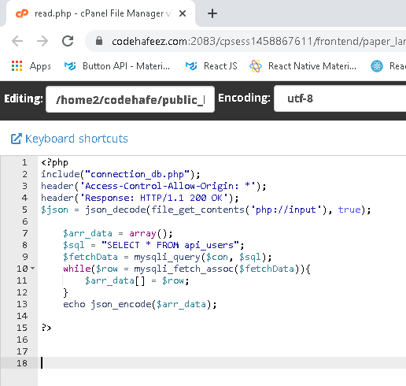
<?php
include("connection_db.php");
header('Access-Control-Allow-Origin: *');
header('Response: HTTP/1.1 200 OK');
$json = json_decode(file_get_contents('php://input'), true);
$arr_data = array();
$sql = "SELECT * FROM api_users";
$fetchData = mysqli_query($con, $sql);
while($row = mysqli_fetch_assoc($fetchData)){
$arr_data[] = $row;
}
echo json_encode($arr_data);
?>

Slide 3
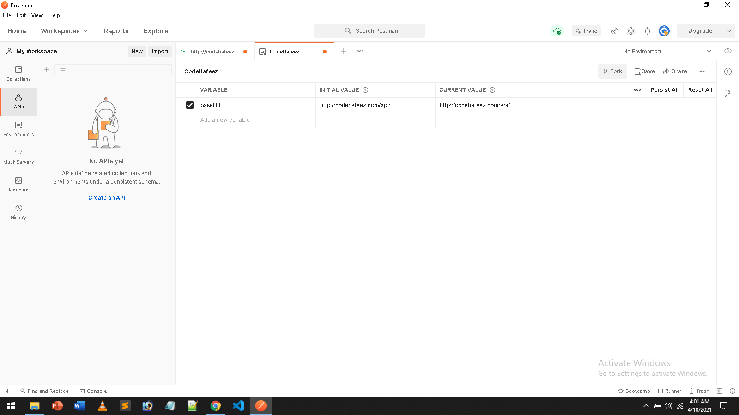
Create Environment Variable

Slide 4
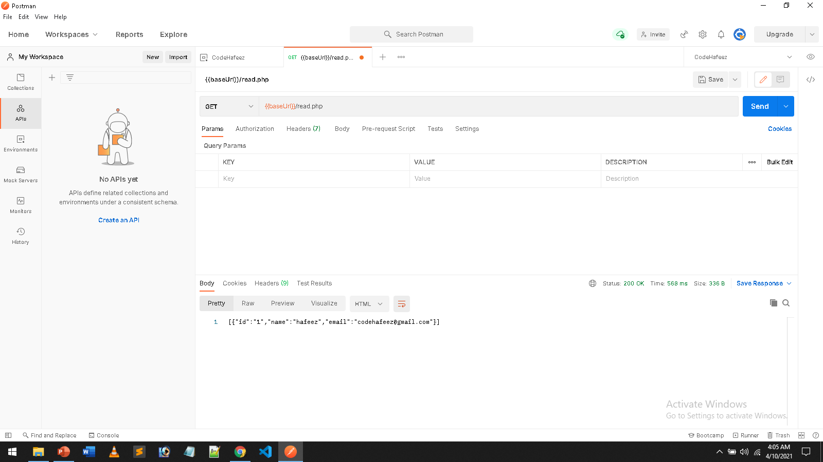

Slide 5
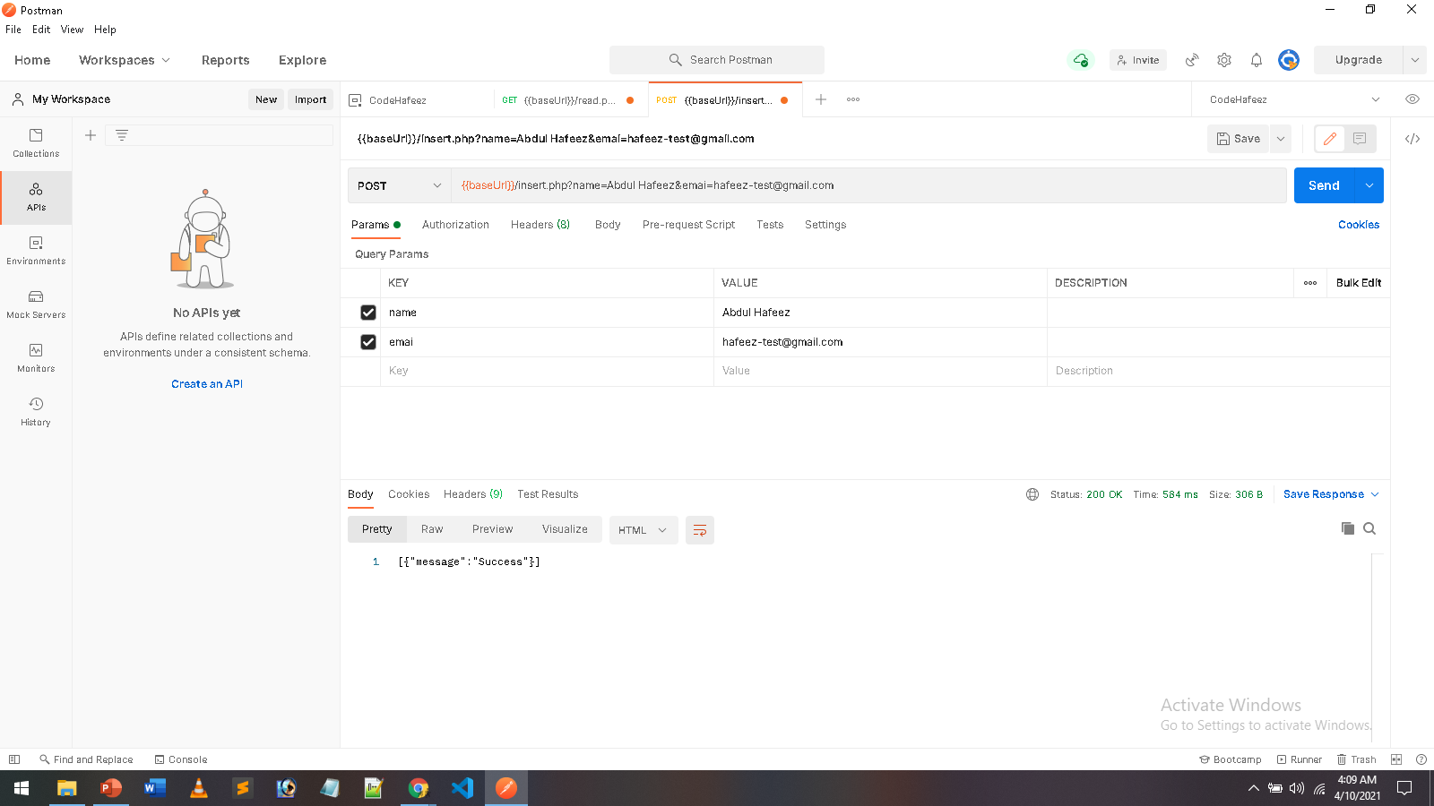

Slide 6
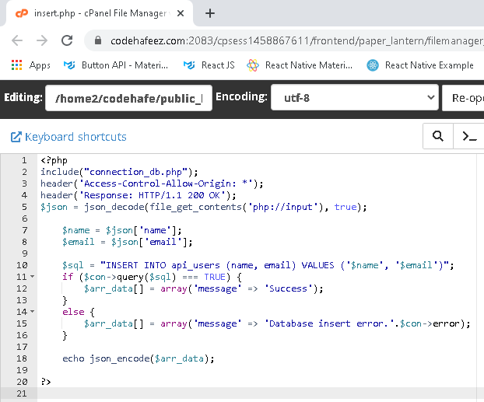
<?php
include("connection_db.php");
header('Access-Control-Allow-Origin: *');
header('Response: HTTP/1.1 200 OK');
$json = json_decode(file_get_contents('php://input'), true);
$name = $json['name'];
$email = $json['email'];
$sql = "INSERT INTO api_users (name, email) VALUES ('$name', '$email')";
if ($con->query($sql) === TRUE) {
$arr_data[] = array('message' => 'Success');
}
else {
$arr_data[] = array('message' => 'Database insert error.'.$con->error);
}
echo json_encode($arr_data);
?>

Slide 7
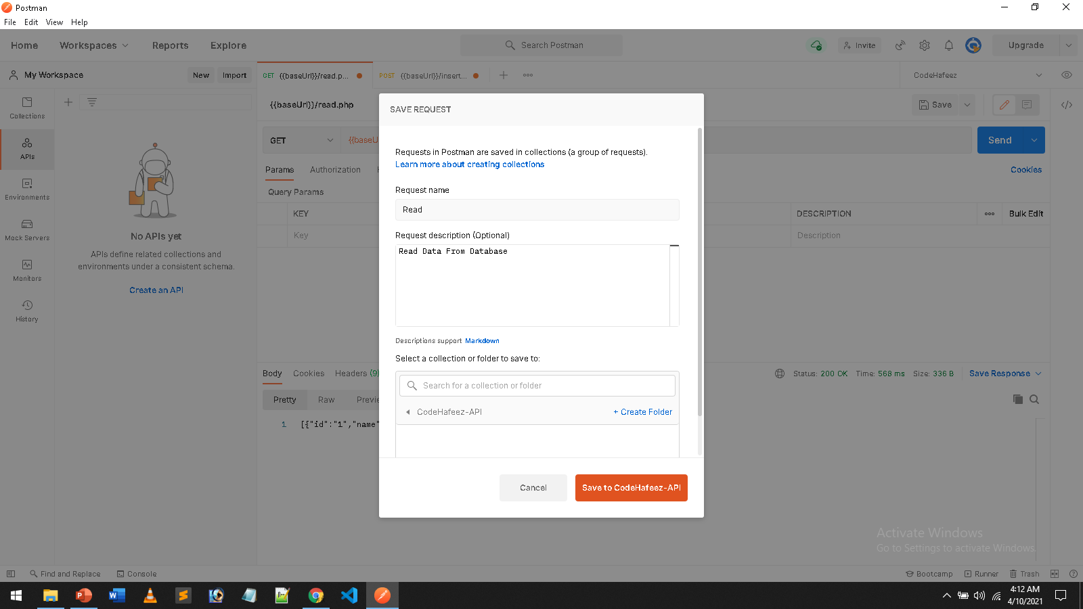

Slide 8


Slide 9
